Slide 1
Arabic Newspaper Sentiment Analysis
Presentation by:
George Sherif
Youssef Amin
Philopateer Amgad
Under the supervision of:
Dr.Mervat Abu-Elkheir and Mayar Osama

Slide 2
Table of contents
01
02
03
04
05
06
Introduction
System Architecture
Methodology
Procedure
Results
Conclusion

Slide 3
01
Introduction

Slide 4


A lot of bad
news!

Slide 5

What if ...
We can have a tool to determine the sentiment of the news?

Slide 6
02
System Architecture

Slide 7

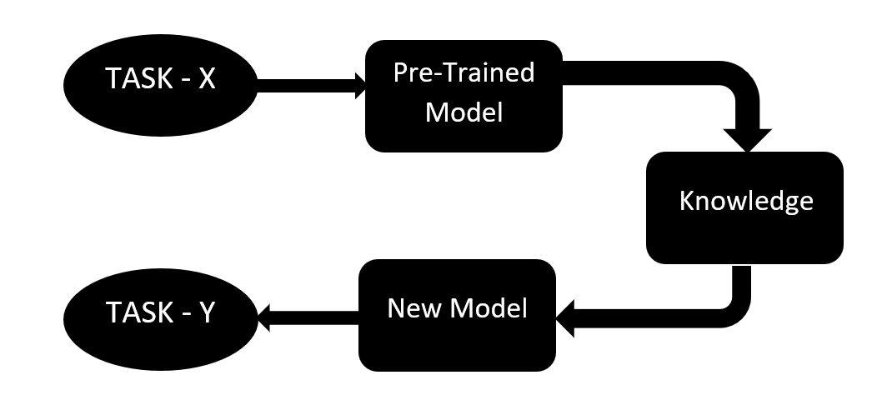
BERT Model
Bert is Bidirectional Encoder (gather context from both sides)
Fine tuning is applied for BERT model to train on our dataset
Data is split into train, validation and test data and then converted to match BERT input shape

Slide 8
03
Methodology

Slide 9
Unsupervised Learning Approaches
(a) VADER
Lexicon and rule-based sentiment analysis tool. Computes a compound sentiment score, which represents the overall sentiment intensity of a text
(b) K-Means Clustering
Partitions data into distinct clusters based on similarities in feature space.
(c) Zero Shot
Leverages the power of pre-trained language models to generalize across different tasks.

Slide 10
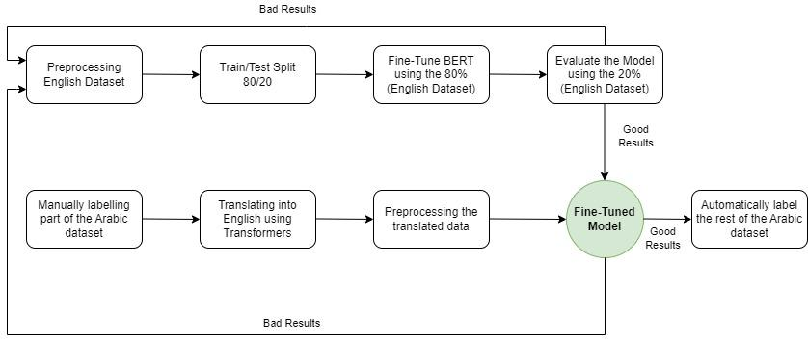
BERT Approach
Fine-tune a normal English BERT model with a ready-labeled English dataset.
Manually label a portion of the Arabic dataset and translate it
Translate the Arabic dataset using MarianNMT and Opus-MT
Validate the fine-tuned BERT model

Slide 11
04
Procedure

Slide 12
Unsupervised Machine Learning
(+) Time efficient
A method to label all of the corpus instead of manual labelling
(-) Inaccuracy
Cannot be completely true.
Lack of metrics to evaluate performance

Slide 13
Fine-tuning BERT
Three different approaches
1. English dataset as is
3.Data Augmentation
2.Preprocessing the English and the translated Arabic datasets

Slide 14
Approach 1: Without Preprocessing
For this approach, we aimed at testing the model using raw data.
No Preprocessing
No Data Augmentation
Dataset had 1812 entries divided equally between positive, neutral, and negative.
Each sentiment had 604 entries.

Slide 15
Approach 2: With Preprocessing
For this approach, we aimed at testing the model using preprocessing methods.
Preprocessing included:
Removing stop words
Removing punctuations
Stemming/Lemmatization (Not actually implemented due to bad results)
Dataset had 1812 entries divided equally between positive, neutral, and negative.
Each sentiment had 604 entries.

Slide 16
Approach 3: With Data Augmentation
For this approach, we aimed at testing the model using data augmentation.
Data augmentation was implemented as follows:
The negative sentiment had the least amount of entries
So we paraphrase each negative entry to double the amount of entries
Dataset had 3624 entries divided equally between positive, neutral, and negative.
Each sentiment had 1218 entries.

Slide 17
For each of the previous steps:
We used 16 epochs and 8 batches
Max length was set to 150 tokens
Padding the sentence was turned on
AdamW optimizer was used to make sure weight decay was applied correctly
A linear schedule function was called to adjust the learning rate during training.
For each epoch, the accuracy of epoch was calculated and the best epoch was chosen for the next step

Slide 18
AR-EN Translation
In this part, 80 entries was chosen from the Arabic dataset to be translated.
An example for the translation:
Arabic : انخفضت أرباح شركة الخليج للمواشي إلى 12.1 مليون درهم في عام ،2010 مقابل 27.6 مليون درهم في 2009
English: The profits of the Gulf Livestock Company fell to 12.1 million dirhams in 2010, compared to 27.6 million dirhams in 2009.
Translation was performed using Opus-MT and MarianNMT Tokenizer

Slide 19
05
Results

Slide 20
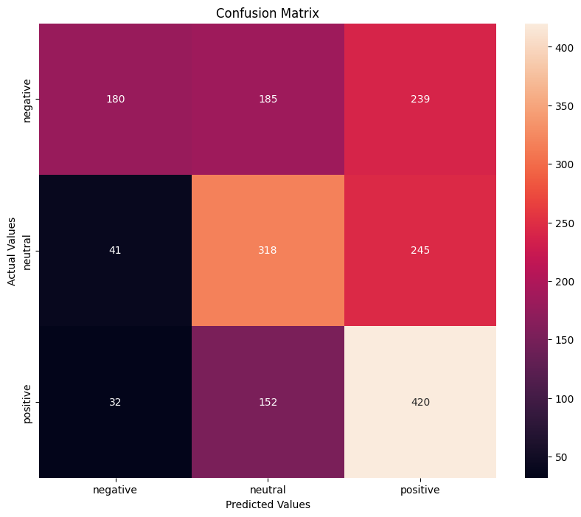
Unsupervised Learning Labelling - VADER
Accuracy 50%

Slide 21
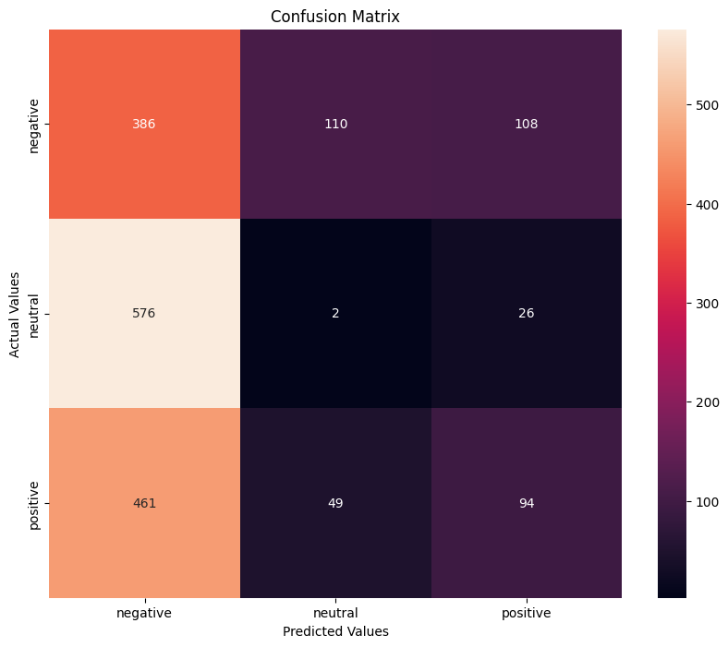
Unsupervised Learning Labelling - K-Means
Accuracy 26.6%

Slide 22
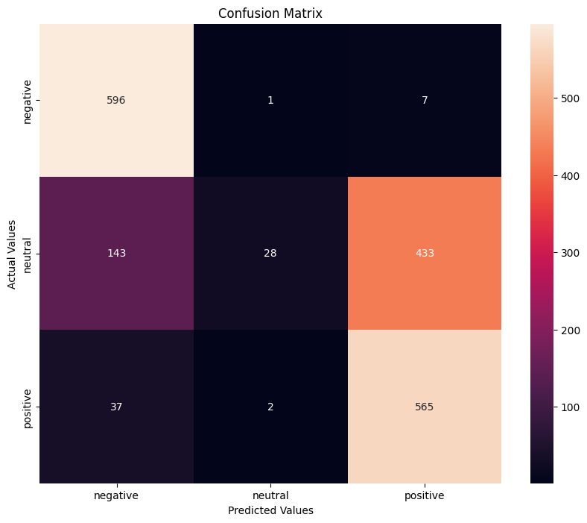
Unsupervised Learning Labelling - Zero Shot
Accuracy 66%

Slide 23
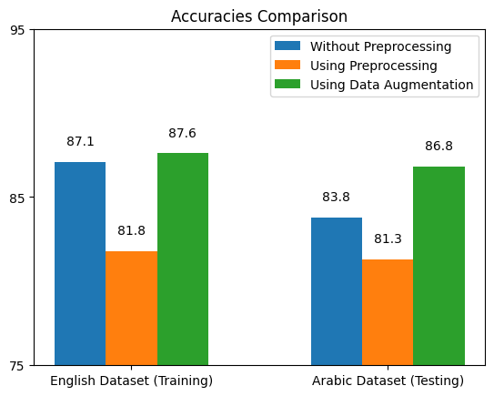
Overview For BERT
Data Augmentation model performed the best in both training and testing.
Highest accuracy reached was around 88% during training and 86% during testing.

Slide 24
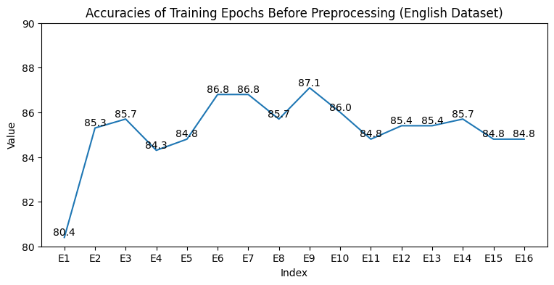
Approach 1: Without Preprocessing
For the training, epoch 9 scored the highest accuracy.
It’s accuracy was about 87%.

Slide 25
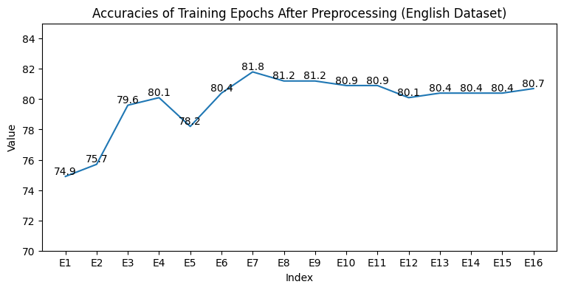
Approach 2: With Preprocessing
For the training, epoch 7 scored the highest accuracy.
It’s accuracy was about 82%.

Slide 26
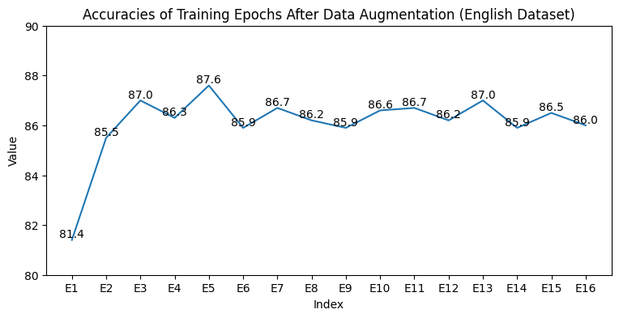
Approach 3: With Data Augmentation
For the training, epoch 5 scored the highest accuracy.
It’s accuracy was about 88%.

Slide 27
Example for the 12th Layer Attention Matrix
Layer 12 attention matrix shape: torch.Size([1, 12, 33, 33])
tensor([[[[9.0370e-02, 7.0198e-02, 3.8721e-02, ..., 3.8658e-03,
8.5830e-02, 5.4248e-02],
[6.2315e-02, 5.7487e-02, 3.7111e-02, ..., 3.1567e-03,
1.6935e-01, 4.0239e-02],
[3.7065e-02, 3.3329e-02, 5.5138e-02, ..., 2.2069e-03,
2.2064e-01, 2.9281e-02],
[9.0491e-03, 7.3193e-03, 6.1967e-03, ..., 5.6488e-02,
3.8198e-01, 8.7678e-03],
[3.0999e-03, 2.4522e-03, 3.8964e-03, ..., 8.0097e-04,
5.2814e-01, 3.2397e-03],
[2.9017e-02, 3.3968e-02, 3.3686e-02, ..., 5.3051e-03,
1.5541e-01, 3.2656e-02]]]], grad_fn=<SoftmaxBackward0>)

Slide 28
06
Conclusion

Slide 29
Conclusion
Our Project aimed at analyzing the sentiment of arabic finance newspaper using 2 main different approaches.
1- Trying unsupervised Learning techniques Bad Results
2- Trying the BERT pretrained model on English Dataset and testing it on arabic dataset Best Results (87.6% with Data Augmentation)

Slide 30
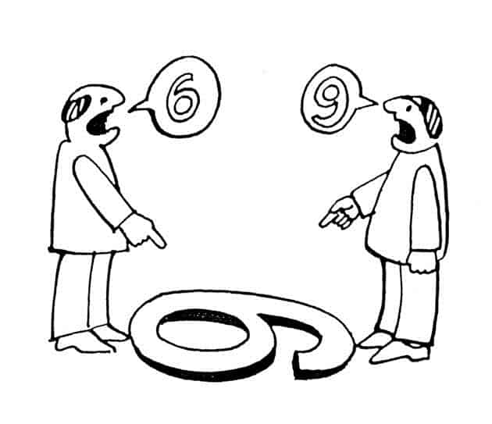
Limitations
Different Perspectives
Limited dataset and the shortage of test data

Slide 31
Future Work
Limitations can be overcome by increasing the number of testing data and searching for better English Datasets
If better results are achieved, then our model can solely classify the entering news into either positive, negative or neutral without any human intervention.

Slide 32
Thank You
Any Questions?

